Slide 1

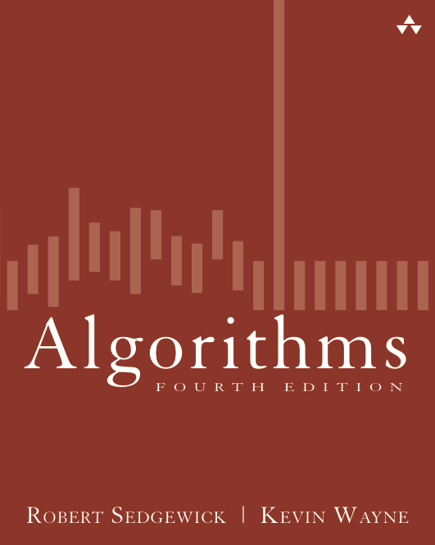
2.1 Elementary Sorts
Algorithms
Robert Sedgewick | Kevin Wayne
rules of the game
selection sort
insertion sort
shellsort
http://algs4.cs.princeton.edu

Slide 2
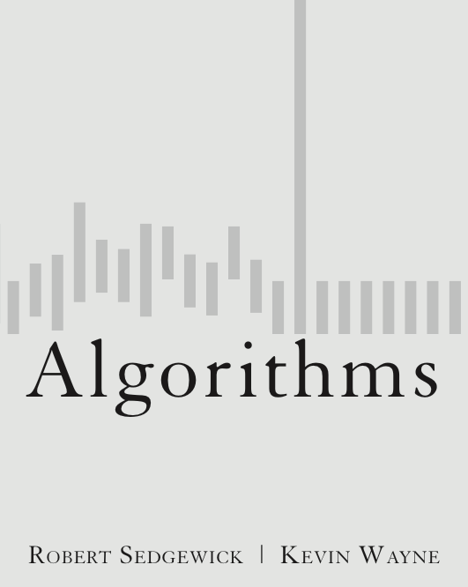
2.1 Elementary Sorts
rules of the game
selection sort
insertion sort
shellsort
shuffling
http://algs4.cs.princeton.edu

Slide 3
Sorting problem
Ex. Student records in a university.
Sort. Rearrange array of N items into ascending order.
Chen | 3 | A | 991-878-4944 | 308 Blair
Rohde | 2 | A | 232-343-5555 | 343 Forbes
Gazsi | 4 | B | 766-093-9873 | 101 Brown
Furia | 1 | A | 766-093-9873 | 101 Brown
Kanaga | 3 | B | 898-122-9643 | 22 Brown
Andrews | 3 | A | 664-480-0023 | 097 Little
Battle | 4 | C | 874-088-1212 | 121 Whitman
item
key
Andrews | 3 | A | 664-480-0023 | 097 Little
Battle | 4 | C | 874-088-1212 | 121 Whitman
Chen | 3 | A | 991-878-4944 | 308 Blair
Furia | 1 | A | 766-093-9873 | 101 Brown
Gazsi | 4 | B | 766-093-9873 | 101 Brown
Kanaga | 3 | B | 898-122-9643 | 22 Brown
Rohde | 2 | A | 232-343-5555 | 343 Forbes

Slide 4
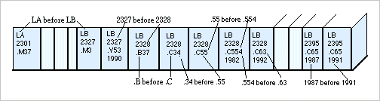
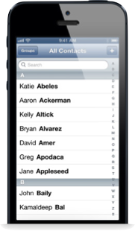
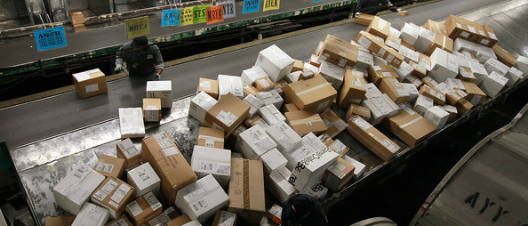














Sorting applications
Library of Congress numbers
contacts
FedEx packages
playing cards
Hogwarts houses

Slide 5
Sample sort client 1
Goal. Sort any type of data.
Ex 1. Sort random real numbers in ascending order.
seems artificial (stay tuned for an application)
public class Experiment
{
public static void main(String[] args)
{
int N = Integer.parseInt(args[0]);
Double[] a = new Double[N];
for (int i = 0; i < N; i++)
a[i] = StdRandom.uniform();
Insertion.sort(a);
for (int i = 0; i < N; i++)
StdOut.println(a[i]);
}
}
% java Experiment 10
0.08614716385210452
0.09054270895414829
0.10708746304898642
0.21166190071646818
0.363292849257276
0.460954145685913
0.5340026311350087
0.7216129793703496
0.9003500354411443
0.9293994908845686
Notes:
sorting random numbers is method of choice for shuffling (better randomness properties than Knuth shuffle) and almost as fast. [see shuffling section]

Slide 6
Sample sort client 2
Goal. Sort any type of data.
Ex 2. Sort strings in alphabetical order.
public class StringSorter
{
public static void main(String[] args)
{
String[] a = StdIn.readAllStrings();
Insertion.sort(a);
for (int i = 0; i < a.length; i++)
StdOut.println(a[i]);
}
}
% more words3.txt
bed bug dad yet zoo ... all bad yes
% java StringSorter < words3.txt
all bad bed bug dad ... yes yet zoo
[suppressing newlines]

Slide 7
Sample sort client 3
Goal. Sort any type of data.
Ex 3. Sort the files in a given directory by filename.
import java.io.File;
public class FileSorter
{
public static void main(String[] args)
{
File directory = new File(args[0]);
File[] files = directory.listFiles();
Insertion.sort(files);
for (int i = 0; i < files.length; i++)
StdOut.println(files[i].getName());
}
}
% java FileSorter .
Insertion.class
Insertion.java
InsertionX.class
InsertionX.java
Selection.class
Selection.java
Shell.class
Shell.java
ShellX.class
ShellX.java

Slide 8
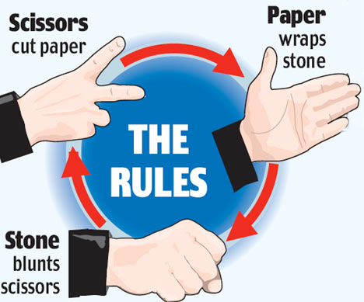
Total order
Goal. Sort any type of data (for which sorting is well defined).
A total order is a binary relation ≤ that satisfies:
Antisymmetry: if both v ≤ w and w ≤ v, then v = w.
Transitivity: if both v ≤ w and w ≤ x, then v ≤ x.
Totality: either v ≤ w or w ≤ v or both.
Ex.
Standard order for natural and real numbers.
Chronological order for dates or times.
Alphabetical order for strings.
No transitivity. Rock-paper-scissors.
No totality. PU course prerequisites.
COS 423
COS 333
COS 226
COS 217
COS 126
violates transitivity
violates totality
Notes:
reflexivity and antisymmetry are easy to satisfy; transitivity is usually the hardest one to guarantee
These 3 properties guarantee have some natural consequences: e.g., if (v < w) and (w < x) then (v < x).
No antisymmetry: "preys on" relation for biological species (e.g., snake and mongoose).
Surprising but true. The <= operator for double is not a total order. (!)
[violates totality: (Double.NaN <= Double.NaN) is false]
However, the compareTo() method for the wrapper type Double is a total order (with NaN being treated as larger than any other value)
Arrays.sort(double[]) has a special case to put all Double.NaN entries together in sorted array

Slide 9
Callbacks
Goal. Sort any type of data (for which sorting is well defined).
Q. How can sort() know how to compare data of type Double, String, and java.io.File without any information about the type of an item's key?
Callback = reference to executable code.
Client passes array of objects to sort() function.
The sort() function calls object's compareTo() method as needed.
Implementing callbacks.
Java: interfaces.
C: function pointers.
C++: class-type functors.
C#: delegates.
Python, Perl, ML, Javascript: first-class functions.
Notes:
deep area that gets us into functional programming

Slide 10
Callbacks: roadmap
data-type implementation
client
public class String
implements Comparable<String>
{
...
public int compareTo(String b)
{
...
return -1;
...
return +1;
...
return 0;
}
}
public class StringSorter
{
public static void main(String[] args)
{
String[] a = StdIn.readAllStrings();
Insertion.sort(a);
for (int i = 0; i < a.length; i++)
StdOut.println(a[i]);
}
}
Comparable interface (built in to Java)
sort implementation
public interface Comparable<Item>
{
public int compareTo(Item that);
}
public static void sort(Comparable[] a)
{
int N = a.length;
for (int i = 0; i < N; i++)
for (int j = i; j > 0; j--)
if (a[j].compareTo(a[j-1]) < 0)
exch(a, j, j-1);
else break;
}
key point: no dependence on String data type
Notes:
Plus. Code reuse for all types of data.
Minus. Significant overhead in inner loop.
This course: enables focus on algorithm implementation; use same code for experiments, real-world data.
Java interface = contract specifying set of methods that a class must implement.
The keywords implements" enforces the contract - class won't compile if it doesn't have specified methods.
Key point: sorting implementation has no dependence on type of data to be sorted
Poll: if we omit the compareTo() method from File, which file will fail to compile?

Slide 11


Comparable API
Implement compareTo() so that v.compareTo(w)
Defines a total order.
Returns a negative integer, zero, or positive integer if v is less than, equal to, or greater than w, respectively.
Throws an exception if incompatible types (or either is null).
Built-in comparable types. Integer, Double, String, Date, File, ...
User-defined comparable types. Implement the Comparable interface.
v
w
w
v
w
v
less than (return -1)
equal to (return 0)
greater than (return +1)

Slide 12
Implementing the Comparable interface
Date data type. Simplified version of java.util.Date.
public class Date implements Comparable<Date> {
private final int month, day, year;
public Date(int m, int d, int y) {
month = m;
day = d;
year = y;
}
public int compareTo(Date that) {
if (this.year < that.year ) return -1;
if (this.year > that.year ) return +1;
if (this.month < that.month) return -1;
if (this.month > that.month) return +1;
if (this.day < that.day ) return -1;
if (this.day > that.day ) return +1;
return 0;
}
}
only compare dates to other dates
Notes:
compare year fields first, then month, then day

